Slide 1
NUMBER
METHODS IN
JAVASCRIPT

Slide 2
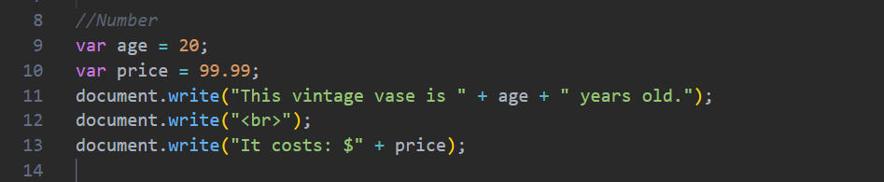
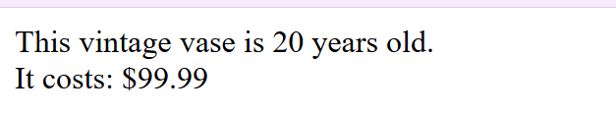
What is a Number?
A number is a data type in JavaScript used to store numeric values. Numbers can be integers, decimal values, positive numbers, or negative numbers. They are used to perform mathematical calculations and store numerical information.
The variable age stores an integer value, while price stores a decimal value. Both are Number data types in JavaScript and can be used in mathematical operations.

Slide 3
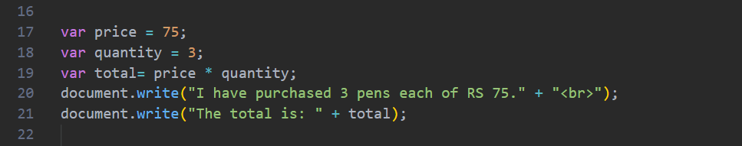
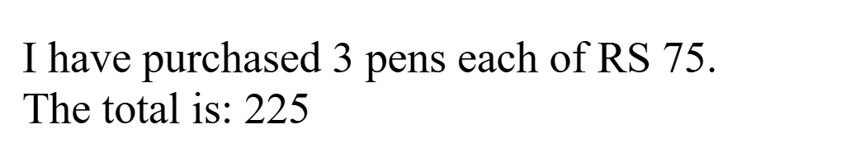
Why do we use Numbers?
Numbers are used to store values that can be calculated or measured, such as age, marks, salary, price, temperature, and quantity. They allow JavaScript programs to perform arithmetic operations and solve mathematical problems.
In this example, the variables price and quantity store numeric values. JavaScript multiplies these values and displays the total price 225.

Slide 4
NUMBER METHODS
They are built-in JavaScript functions used to convert, check, and format numeric values. They help developers perform calculations more easily and display numbers in different formats.
1. Number()
The Number() method converts different data types such as strings and Boolean values into numbers. If the conversion is not possible, it returns NaN (Not a Number).
Number()
parseInt()
parseFloat()
isFinite()
isInteger()
toFixed(x)
toPrecision(x)

Slide 5
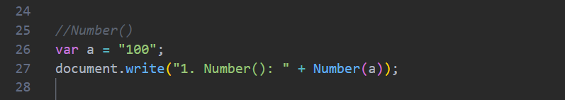
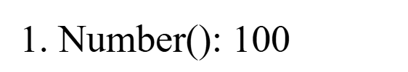
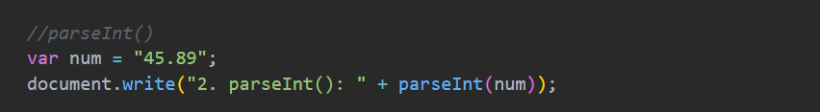
The variable a contains the string "100". The Number() method converts the string into the numeric value 100, allowing it to be used in calculations.
2. parseInt()
The by reading parseInt() method converts a string into an integer only the whole number. It ignores decimal values and stops reading when it encounters a non-numeric character.

Slide 6

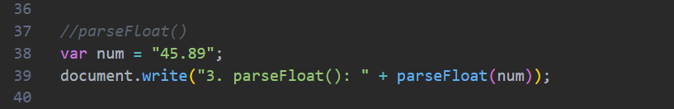
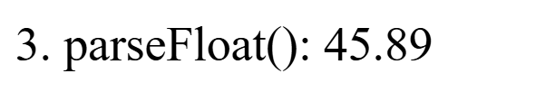
The string "45.89" is converted into the integer 45. The decimal part .89 is ignored because parseInt() only returns whole numbers.
3. parseFloat()
The parseFloat() method converts a string into a floating-point (decimal) number. It keeps the decimal portion of the value.
The parseFloat() method converts a string into a decimal number and keeps the digits after the decimal point.

Slide 7
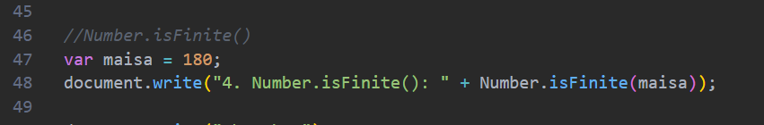
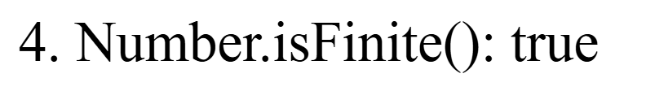
3. Number.isFinite()
This method checks whether a value is a finite number. It returns true for valid finite numbers and false for Infinity, -Infinity, or NaN
The value 150 is a valid finite number, so Number.isFinite() returns true.
5. Number.isInteger()
This method checks whether a value is an integer. If the value is a whole number, it returns true; otherwise, it returns false.

Slide 8
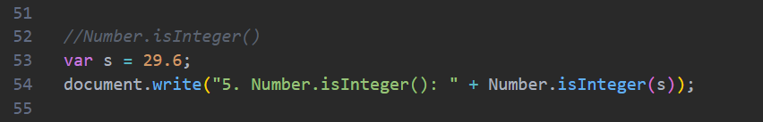
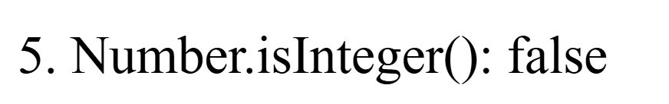
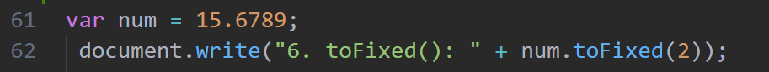
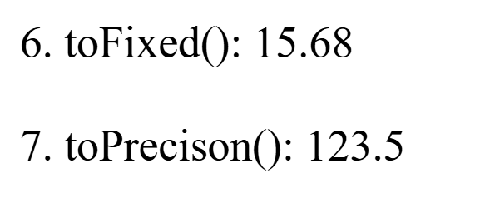
6. toFixed()
This method formats a number by rounding it to a specified number of decimal places. It returns the result as a string.
The value 29.6 is not a whole number, so Number.isInteger() returns false.
The number 15.6789 is rounded to 2 decimal places, producing the result 15.68.

Slide 9
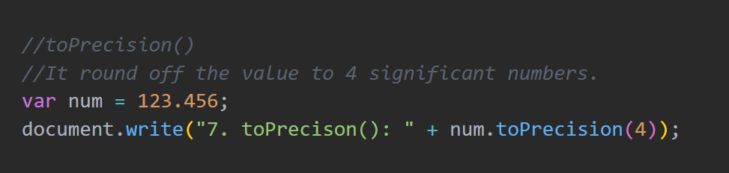
7. toPrecision()
This method formats a number to a specified number of significant digits. It returns the formatted value as a string.
The toPrecision(4) method keeps 4 significant digits. Therefore, the number 123.456 becomes 123.5 after rounding
Why do we need Number Methods?
They help us convert, check, and format numeric values in JavaScript. They make calculations easier, improve the display of numbers, and reduce the need for complex code. These methods are commonly used in billing systems, banking applications, shopping carts, scientific calculations, and data processing.

Slide 10
MATH METHODS IN JAVASCRIPT

Slide 11
What is the Math Object?
The Math object is a built-in JavaScript object that provides mathematical constants and methods. It allows us to perform calculations such as rounding numbers, finding square roots, generating random numbers, and calculating powers without creating a Math object.
What are Math Methods?
Math methods are built-in JavaScript functions that perform mathematical operations such as rounding numbers, finding maximum and minimum values, calculating square roots and powers, and generating random numbers.
Why do we use Math Methods?
Math methods are used to perform mathematical calculations quickly and accurately. They help programmers round numbers, generate random values, calculate powers, and solve mathematical problems without writing lengthy code.

Slide 12
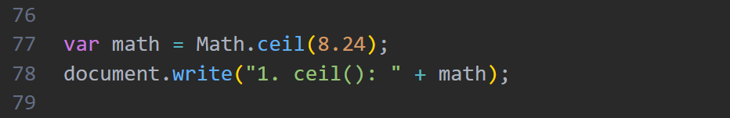
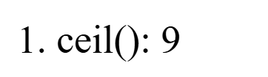
MATH METHODS
1. Math.ceil()
This method rounds a number up to the nearest integer.
Math.ceil()
Math.floor()
Math.round()
Math.trunc()
5. Math.max()
6. Math.min()
7. Math.sqrt()
8. Math.cbrt()
9. Math.pow()
10. Math.random()
11. Math.abs()
12. Math.PI
The number 8.2 is rounded upward to the nearest whole number, which is 9.

Slide 13
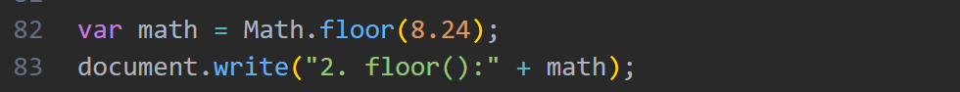



2. Math.floor()
The Math.floor() method rounds a number down to the nearest integer.
3. Math.round()
This method rounds a number to the nearest integer. Decimal values of 0.5 or greater are rounded up, while values less than 0.5 are rounded down.
The number 8.9 is rounded downward to the nearest whole number, which is 8.
Since the decimal part is 0.5, the number is rounded up to 9.

Slide 14
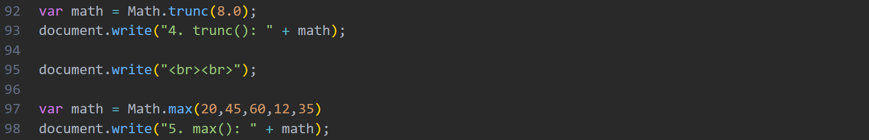
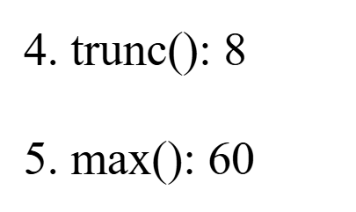
4. Math.trunc()
This method removes the decimal part of a number and returns only the integer portion.
5. Math.max()
This method returns the largest value from a list of numbers.
The decimal part .95 is removed, leaving only the integer value 8.
Among the given numbers, 60 is the largest value, so Math.max() returns 60.

Slide 15
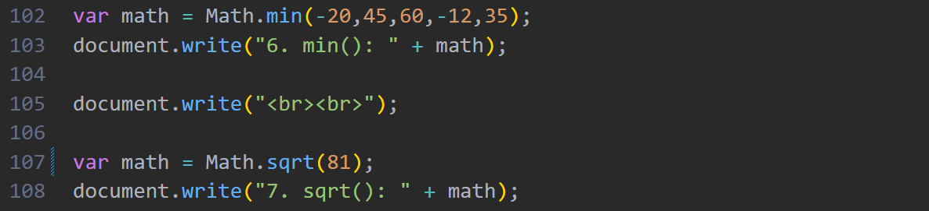
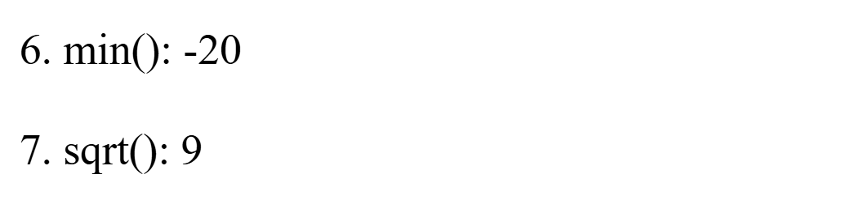
6. Math.min()
This method returns the smallest value from a list of numbers.
7. Math.sqrt()
This method returns the square root of a number.
The smallest value in the given list is -20, so Math.min() returns -20.
The square root of 81 is 9, so Math.sqrt() returns 9.

Slide 16
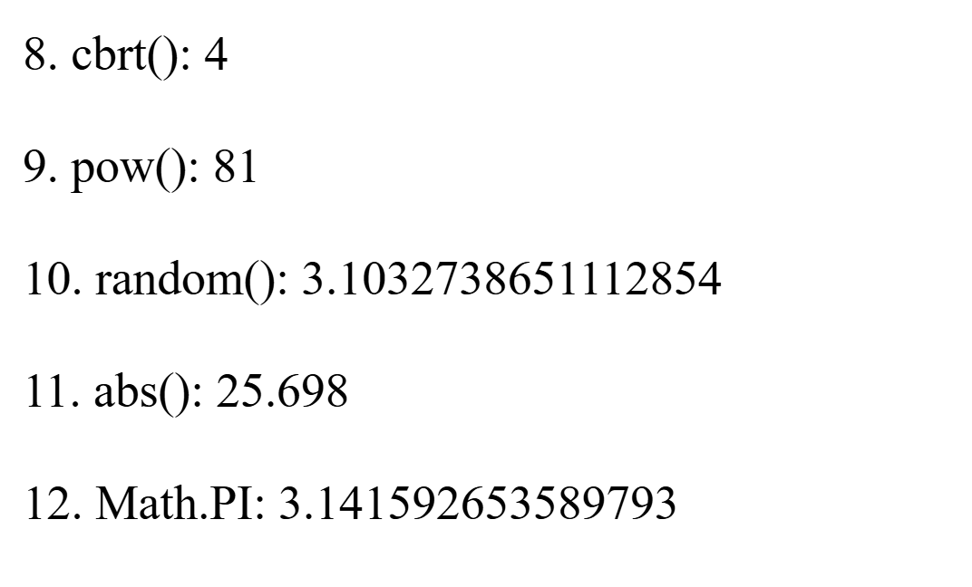
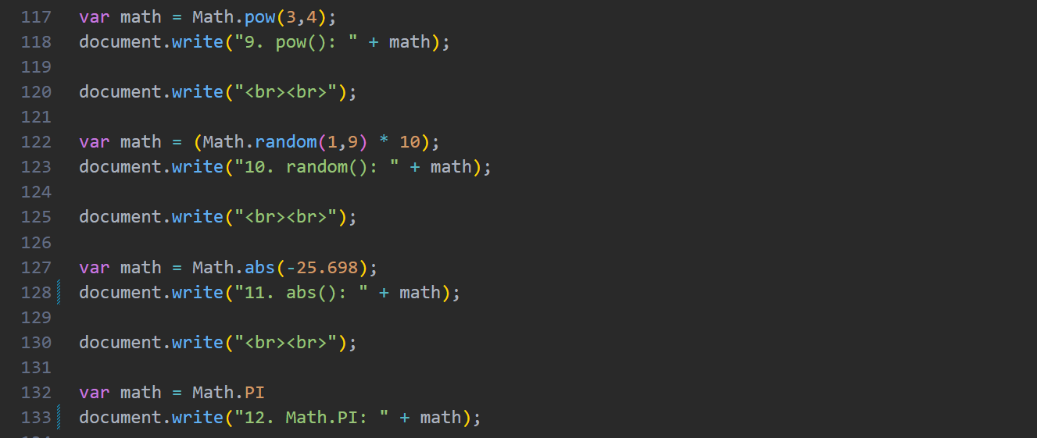
8. Math.cbrt()
This method returns the cube root of a number.
9. Math.pow()
This method returns the value of a number raised to a specified power.
Since 4 × 4 × 4 = 64, the cube root of 64 is 4.
The method calculates 3⁴, which equals 81.

Slide 17
10. Math.random()
This method generates a random decimal number between 0 (inclusive) and 1 (exclusive) each time the code is executed.
11. Math.abs()
This method returns the absolute (positive) value of a number.
The negative number -35 is converted into its positive value 35.

Slide 18
12. Math.PI
This is a mathematical constant that returns the value of π (pi), approximately 3.14159.
Why do we need Math Methods?
Math methods help us perform mathematical calculations quickly and accurately in JavaScript. They provide built-in functions for rounding numbers, finding maximum and minimum values, generating random numbers, calculating powers, square roots, cube roots, and absolute values. These methods reduce coding effort and are widely used in calculators, games, banking systems, scientific applications, and data analysis.

Slide 19
THANK YOU

